Slide 1



Video Games Sales & Success Prediction using PySpark
Team 07
Sandeepkumar Vijaya Kumar
Nishok Ilangovan
Rohit Ananthan
Notes:
Illustration: Freepik

Slide 2
Overview
Steam is a video game digital distribution service and storefront
developed by Valve Corporation.
Develop predictive models, Algorithms for forecasting video game success on Steam to
Enhance stakeholder decision-making.
Optimize marketing and inventory strategies.
Boost profitability and market positioning.
Methodology
Analyze games data with PySpark.
Key factors: genre, game tags, ratings and publishers.
Foster recommendations to improve business performance.

Slide 3






Exploratory Data Analysis
Feature Engineering
Inference and recommendation
Course
of
action
Dataset Acquirement
Data Cleaning & Preprocessing
Model utilization
Notes:
Illustration: Freepik

Slide 4

Vector assembler
Classification Modelling and frequent pattern mining
Min Max scaling
One hot encoding
Cluster Analysis
String indexing
Graphframe Analysis
Methodologies
Notes:
Illustration: Freepik

Slide 5

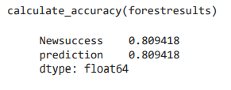
Prediction of New Game’s Commercial Success
Methodology: Machine Binary Classification Model ( Random Forest )
Created a predictive model that will predict whether a game will be a hit using Binary Classifiers like the Random Forest Model.
models utilize various features such as genre, developer, publisher, price, and user ratings to predict the likelihood of a game's success.
Outcome was a Model with accuracy of 81 % and the relative area under ROC of 0.73
Future Scope:
Early Decision Making
Feedback loop for iterative improvements
Insights into potential Success Factors

Slide 6
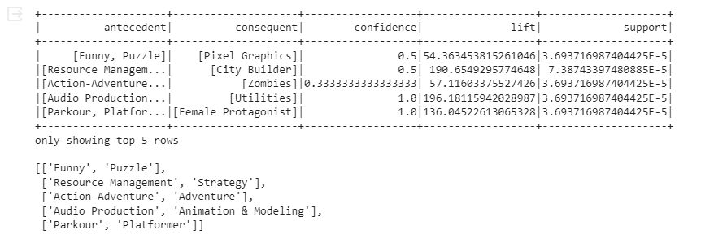
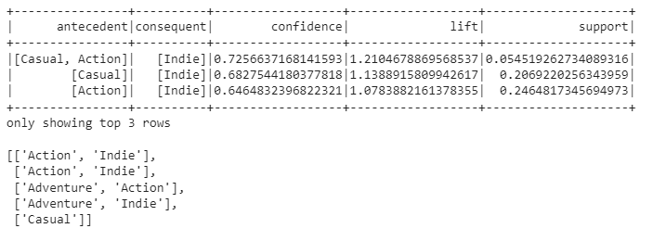
2. Analyzing Pattern of Game’s Sales
Methodology: Frequent Pattern Mining
Created a association rule from frequent pattern algorithm using Game Tags Eg. Action, Adventure
Higher Lift and Support Higher Confident and Support

Slide 7
2. Analyzing Pattern of Game’s Sales (Contd)
Business Problems
Increasing Revenue Through Bundled Game Sales (Higher Lift and Support)
Tags
Funny and Puzzle
Action-Adventure
Enhancing Customer Segmentation for Targeted Marketing (Higher Confident and Support)
Tags
‘Action' and 'Indie',
'Adventure' and 'Indie'

Slide 8
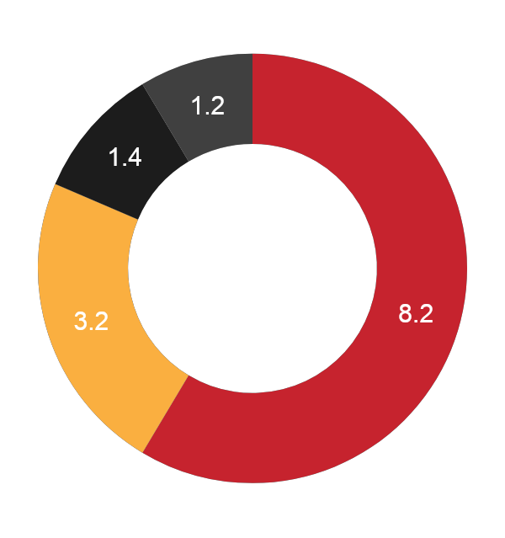

3. Cluster Analysis
The goal is to uncover patterns and categorize games based on a select few attributes.
Feature Selection
Feature Engineering
Determining optimal K value
Cluster Interpretation

Slide 9
Outcomes of Cluster Analysis
Cluster 1: "Highly Rated, High Achievements, Premium Price"
Eg: Team Fortress Classic, Day of Defeat and Deathmatch Classic
Cluster 2: "Moderate Ratings, Achievements, and Mid-range Price"
Eg: Counter-Strike, Half life 2, Killing Floor
Cluster 3: "Positive Ratings, Few Achievements, Affordable"
Eg: Counter-Strike: Global Offensive
Cluster 4: "Varied Ratings, High Achievements, Diverse Price Range"
Eg: Team Fortress 2, Dota 2, Player Unknown’s Battleground

Slide 10
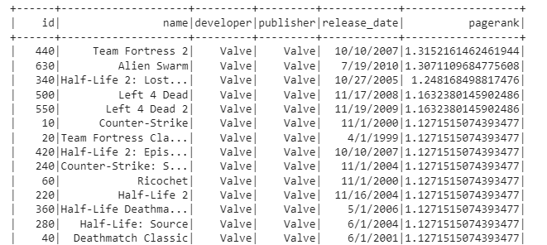
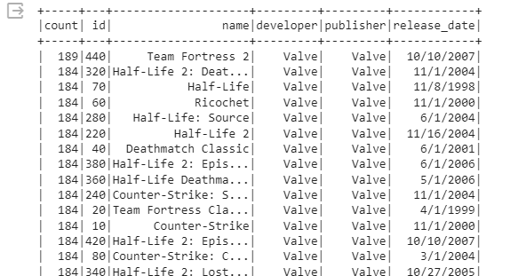
4 . Analyzing Relationships of Game’s Attributes
Methodology: PySpark GraphFrames Page Ranking and Triangle Counts
Created a graph frames from game’s shared platforms and properties.
Identifying InDegrees and OutDegrees
Analyzing Page Rankings and Triangle Counts
Page Rankings Triangle Counts

Slide 11
Conclusion
Enhanced Customer Appeal
Expanded Audience Reach
Increased Sales Potential
Cross Selling Opportunities
Notes:
Illustration: Freepik

Slide 12
Notes:
Illustration: Freepik

